Slide 1
HackZon 2022
Team name: gghackers
Team members:
Ganesh d
Gagan v

Slide 2
Project Objective
The main objective of this web application is to develop a heart prediction system, the system can discover with diseases from the heart data set.
This web application aims to exploit machine learning on the medical dataset to assist in the prediction of the heart diseases.
Reduce the cost of medical test.
To help avoid human biases.

Slide 3
Introduction
It is difficult to identify heart disease because of several contributory risk factors such as diabetes, high blood pressure, high cholesterol, abnormal pulse rate and many other factors.
The diagnosis of heart disease is a challenging task, which can offer automated prediction about the heart condition of patient so that further treatment can be made effective.
The diagnosis of the heart disease is usually based on signs, symptoms of the patient.
The severity of the disease is classified based on Random Forest Classifier algorithm.
The nature of heart disease is complex and hence, the disease must be handled carefully. Not doing so may affect the heart or cause premature death.

Slide 4
Problem Statement
India’s doctor-population to the patient-population is 1:854.
We can use this prediction application to predict if the patient is vulnerable to any kind of heart disease.
If it is a label 1 (1 : heart disease), then the patient is allowed to consult the doctor. In this manner we can reduce the pressure on the doctors. And give more importance to these patients.

Slide 5
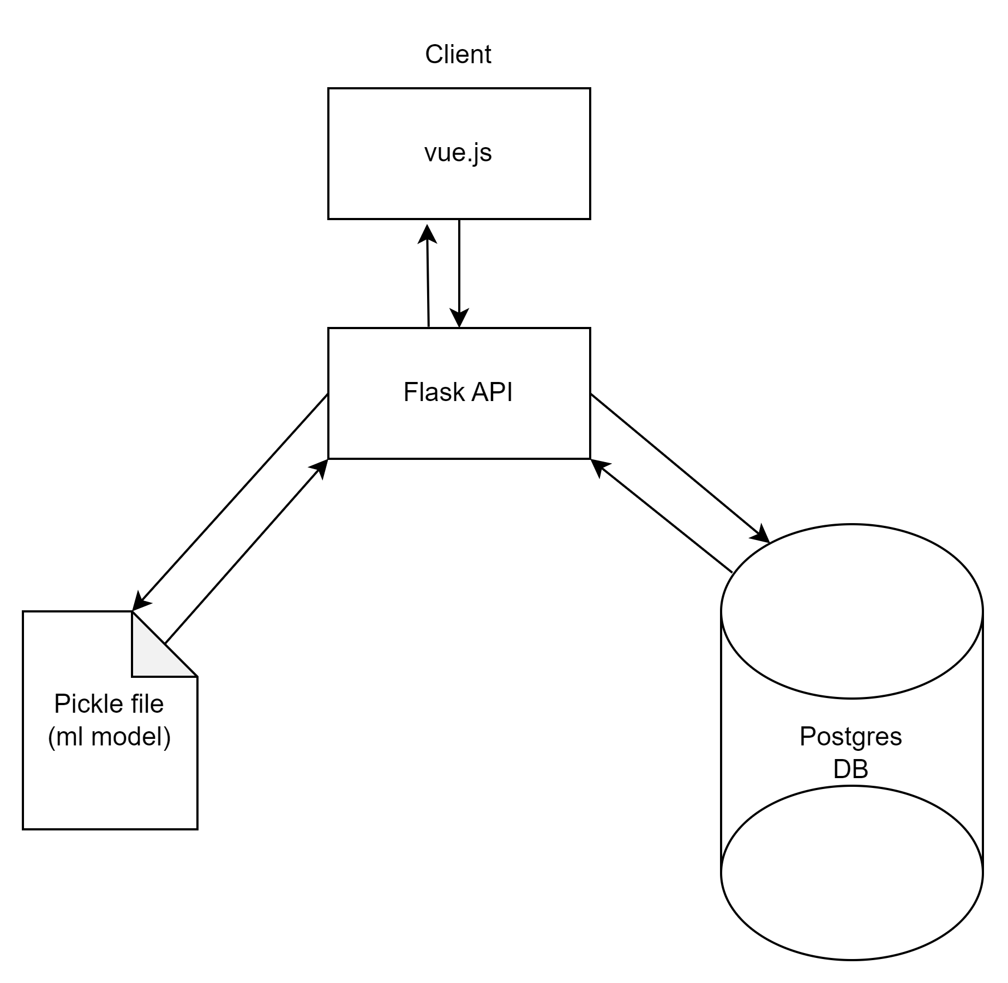
Implementation

Slide 6
Functionality of the project
Vue.js - JavaScript framework for building the front end of the web application.
Flask - Flask Framework is used for building the backend of the web application.
Scikit-learn - Used for training the machine learning model.

Slide 7
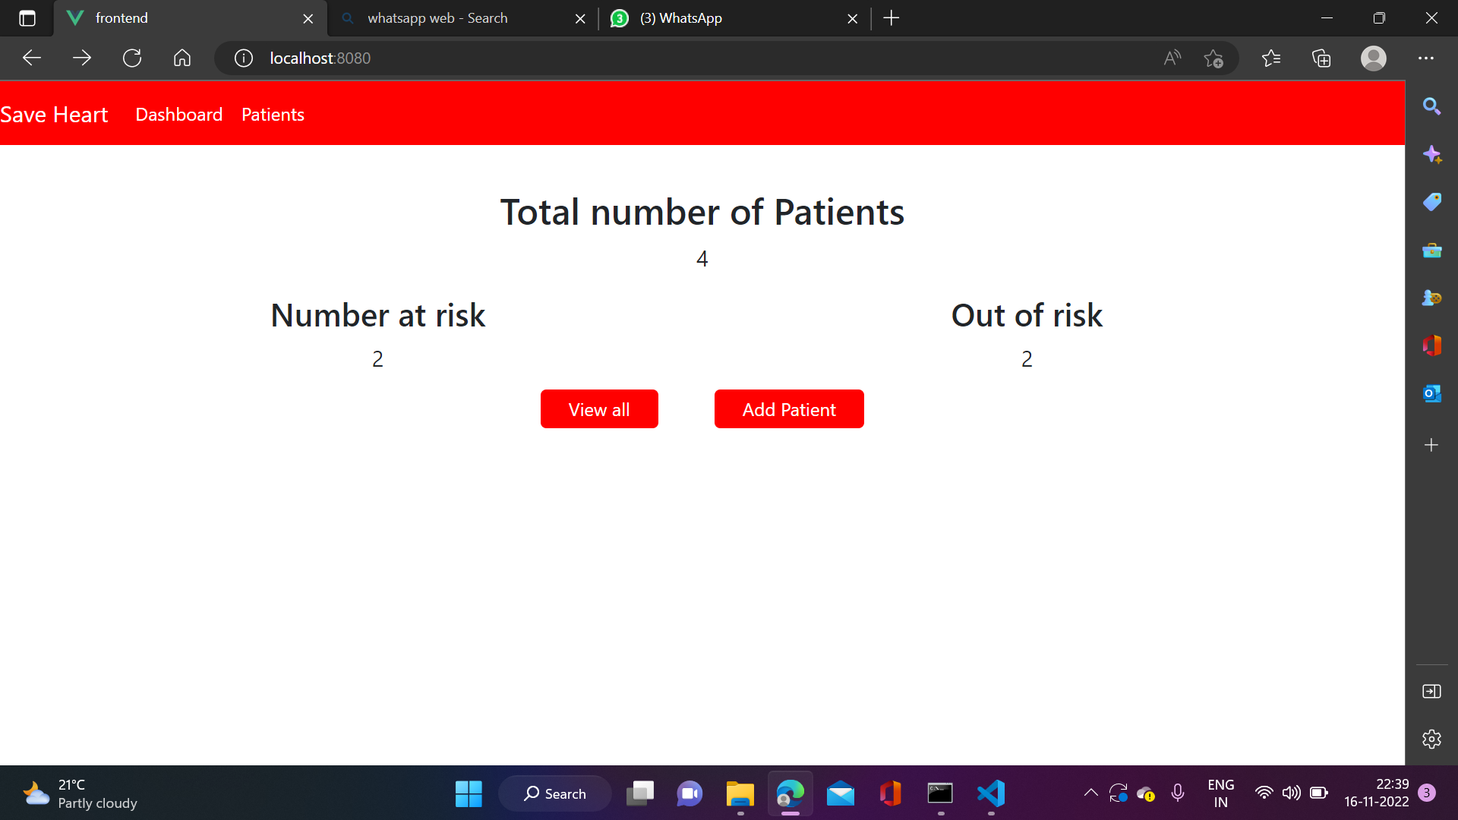

Slide 8
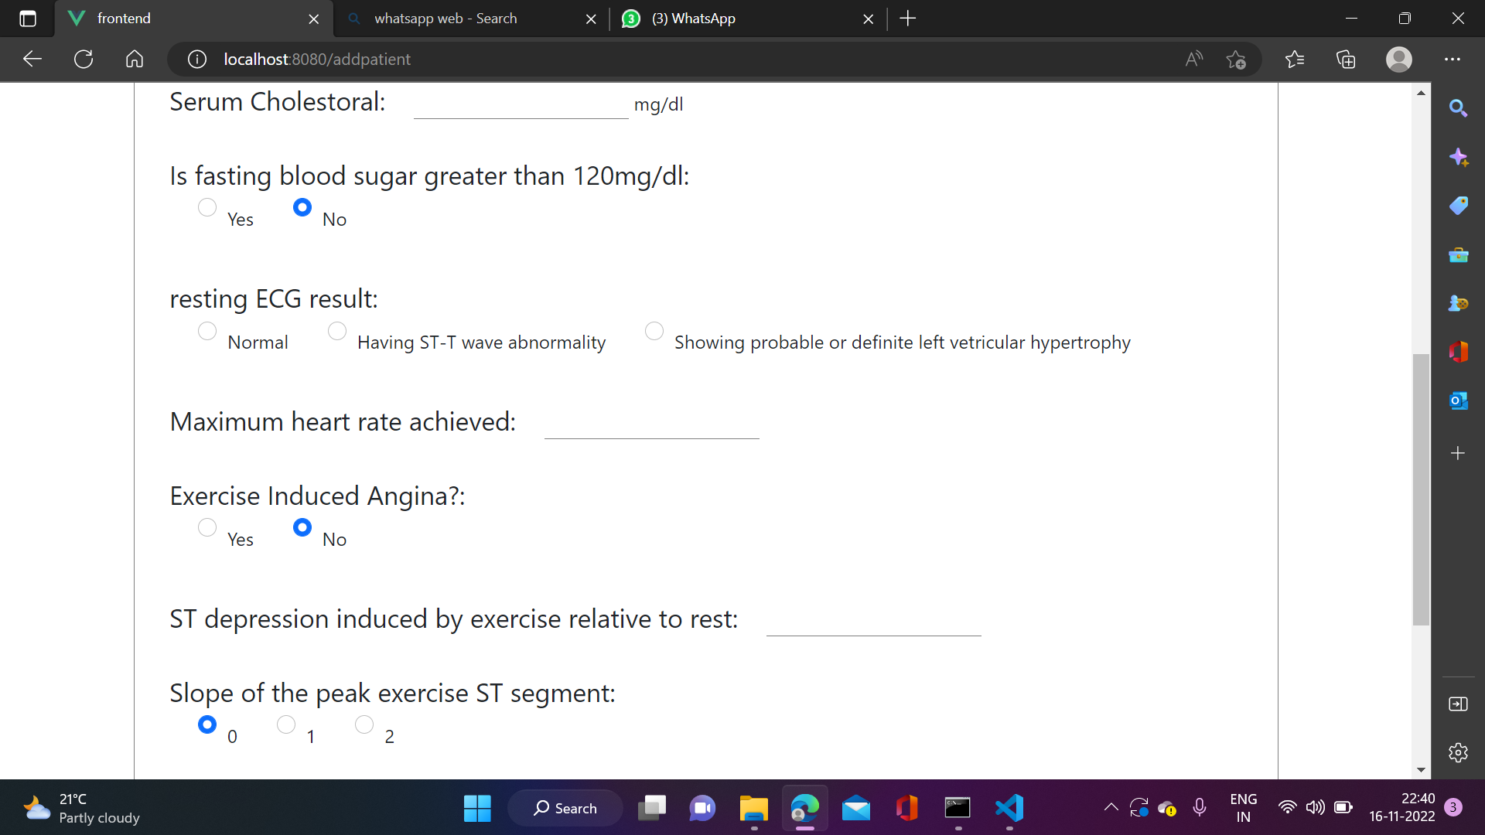
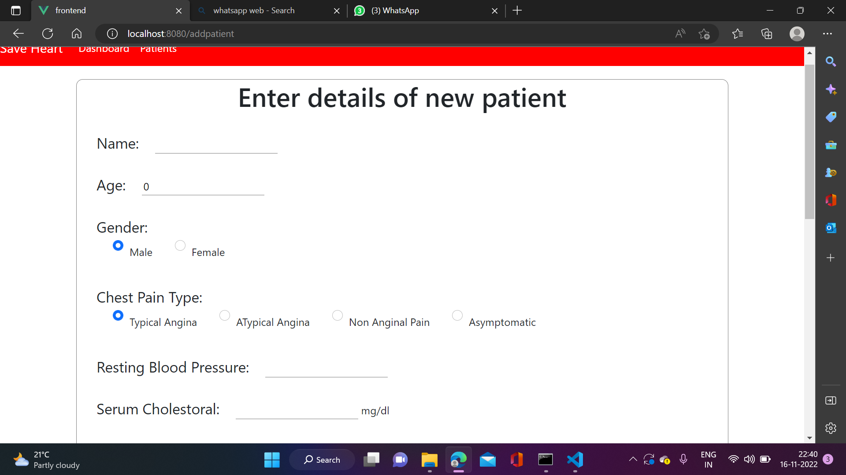

Slide 9
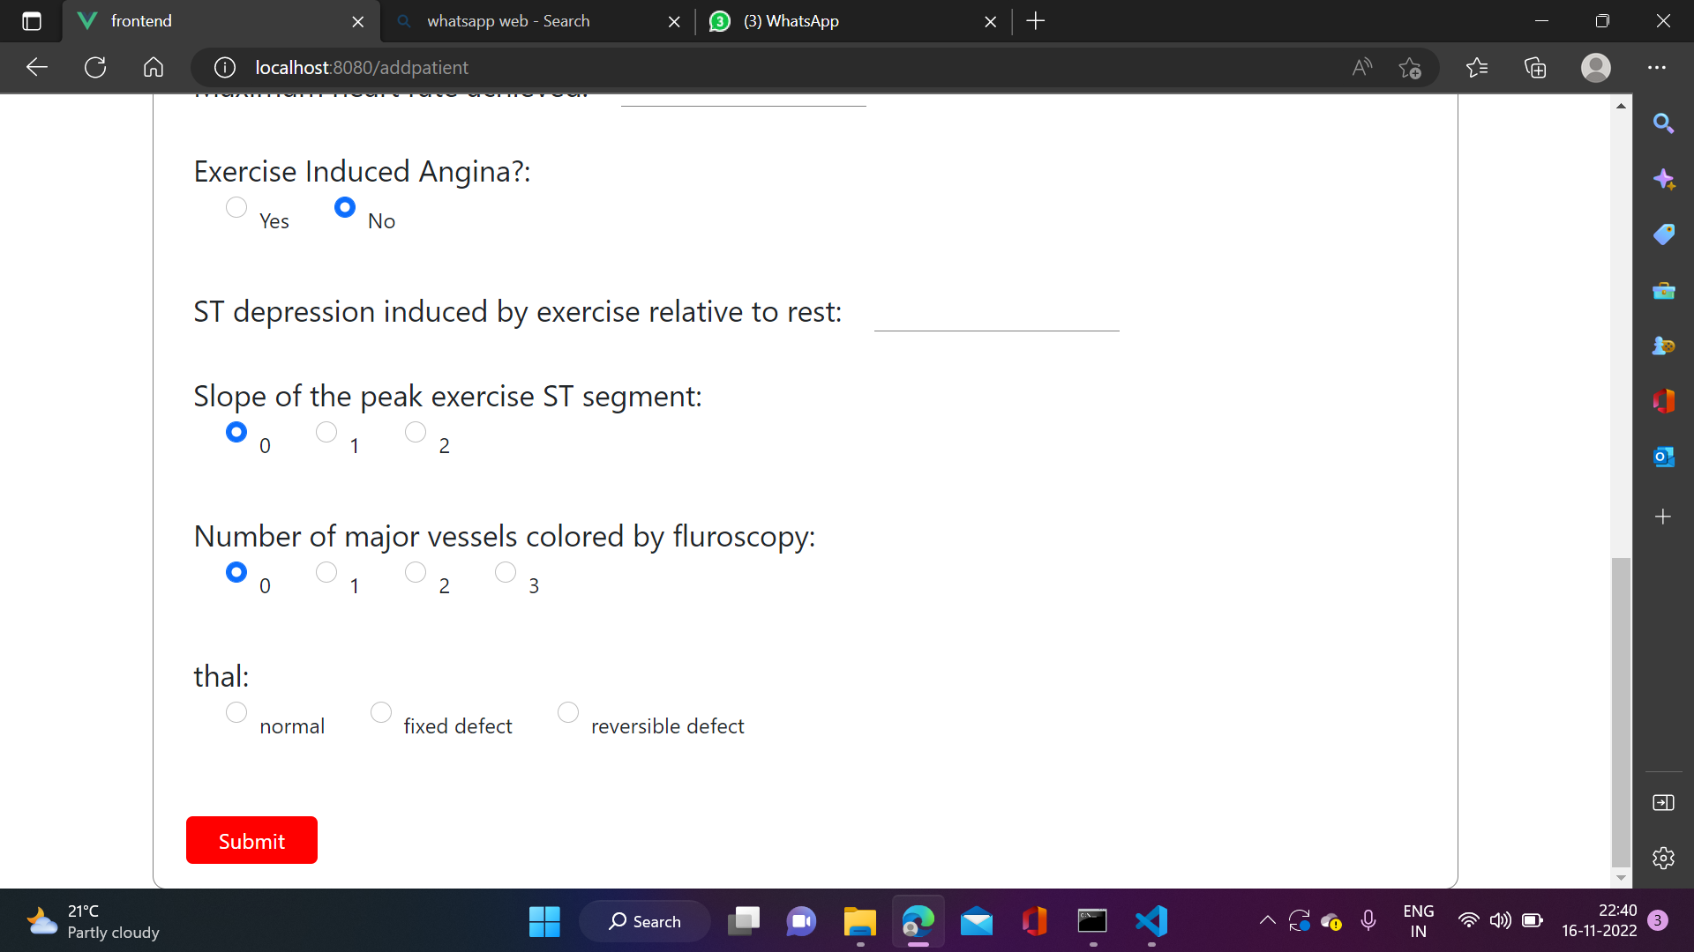

Slide 10
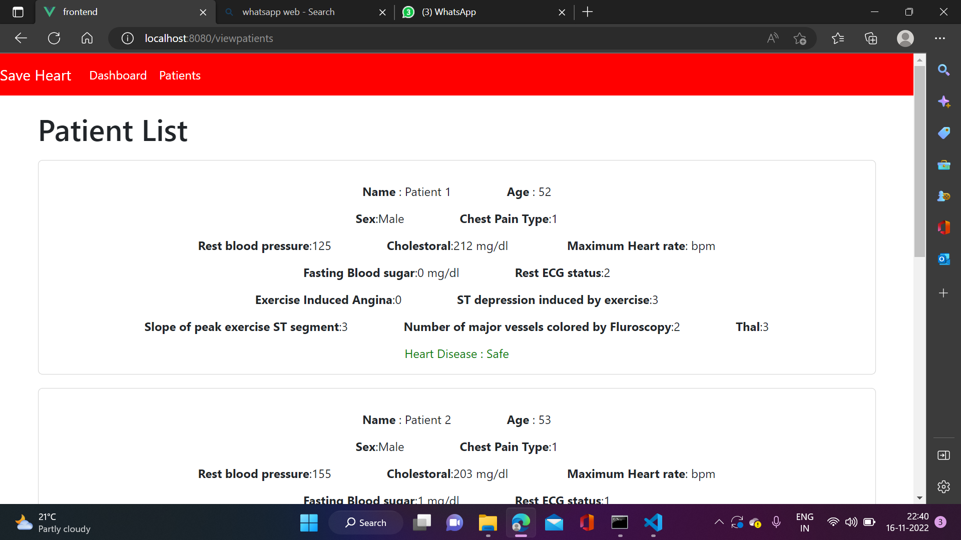

Slide 11
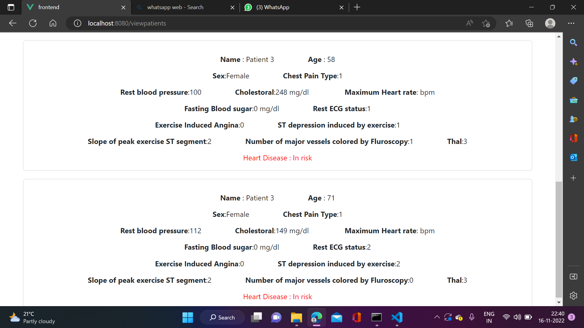

Slide 12
Future Plans
Improve the UI and add more analysis using charts

Slide 13
Thank You
Team Name - GGhackers

